Slide 1
Mental Health
Ashley Northam

Slide 2
Communicate
Open Communication in our Relationships:
It is important to have open communication and a good trust with others. Work towards having hard or delicate conversations that are not always pleasant. We may hear of things we may not approve of and or struggles that others are having that we do not relate to. We do not understand. We may hear things that are scary.
Notes:
We are hearing from some very skilled and talented mental health professionals. There are times when we really cannot “fix” our thinking ourself or when we’ve experienced or are experiencing something that is really affected our everyday function. I’m hopeful that we are moving to a place where mental health and well being are regarded with as much strength as physical health and well being.
Hearing how others are feeling or functioning may bring up feelings and experiences that we have not experienced.

Slide 3
Ways to Support Others
Validate – do not dismiss – just because it is not our experience does not mean its not valid
Be a good friend, a good listener, keep confidences – we don’t always need to offer advice or have answers. Sometimes people just want to be able to talk about how they feel, what they are struggling with. They don’t always expect us to fix it.
Recognize that we all need “downtime”
Downtime looks different to everyone. Some need quiet, some need company.
Be encouraging.
Applaud attempts, applaud success

Slide 4
Ways to Support Others
Find small ways to support others.
- Set small check ins- text, phone calls, conversation
Work towards small steps for more activity and improvement
- If the person declines do not give up. Try again and let them off without guilt
Function
-Realize that mental health can affect a person’s percentage of function- lower expectations when appropriate of what they should be able accomplish.

Slide 5
Label and Identify Emotions

Slide 6
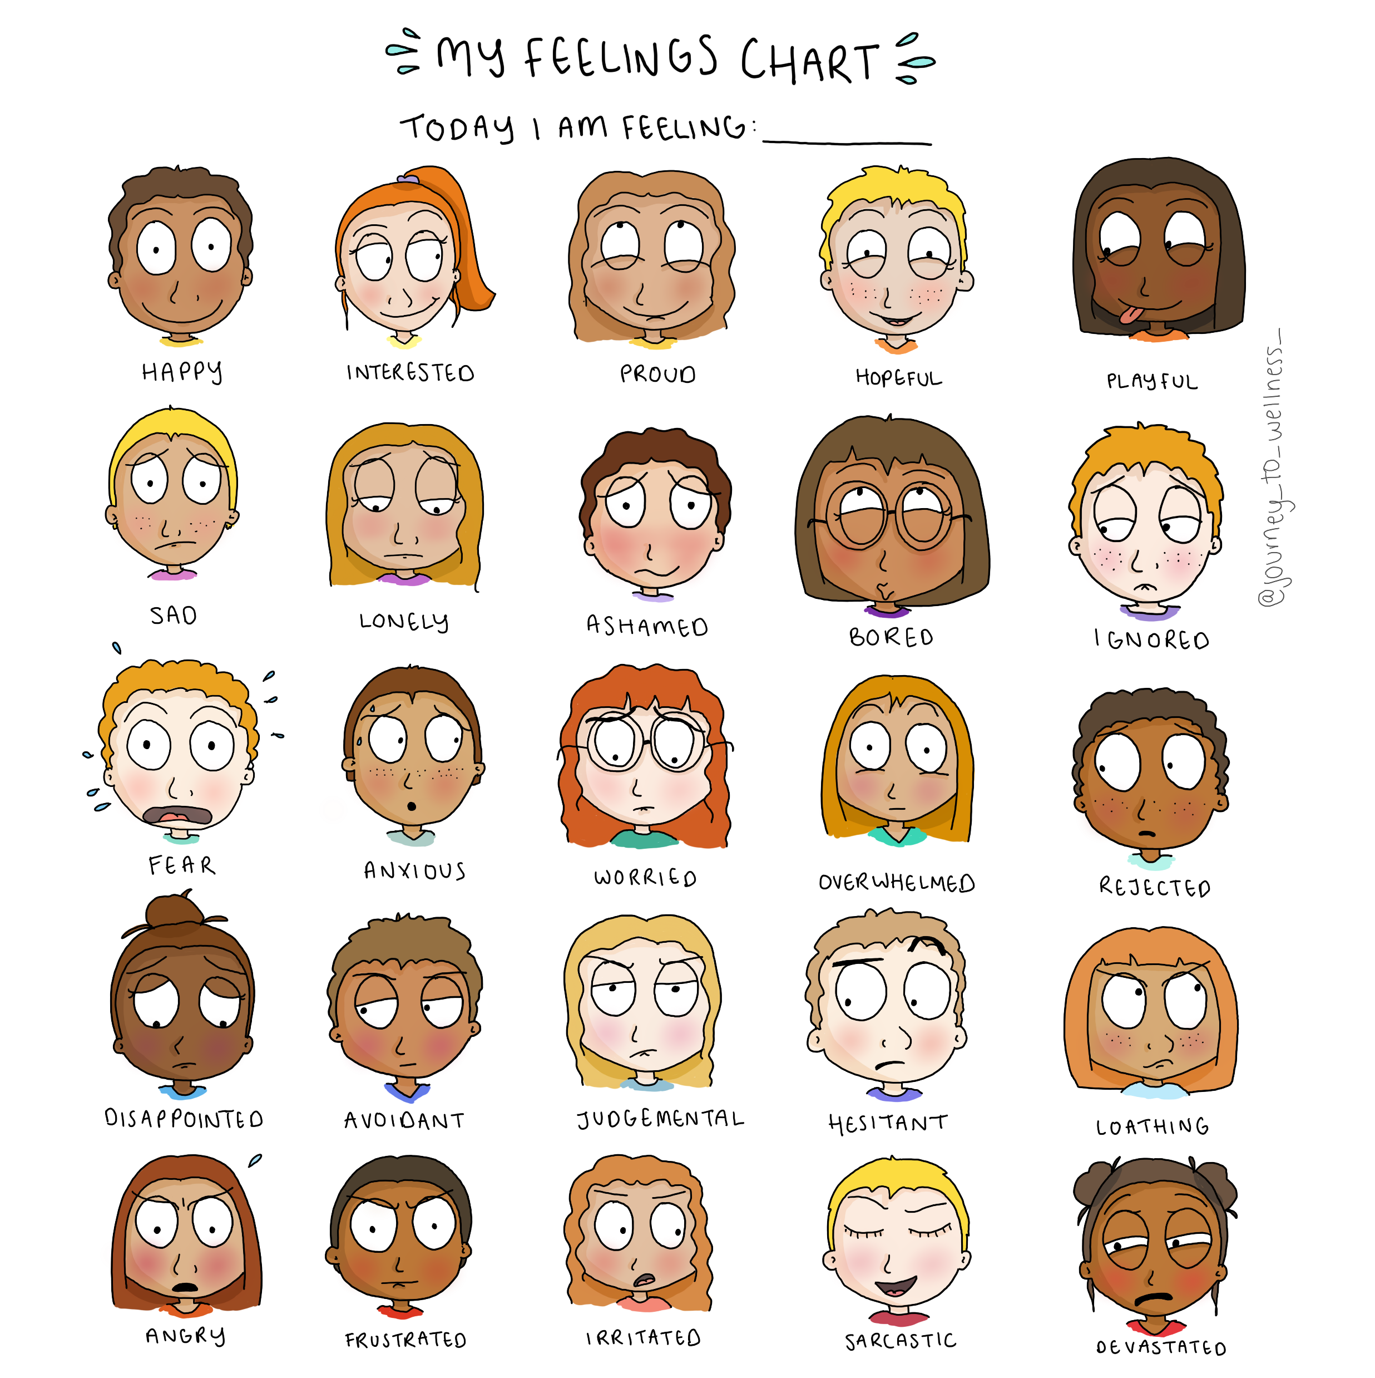

Slide 7
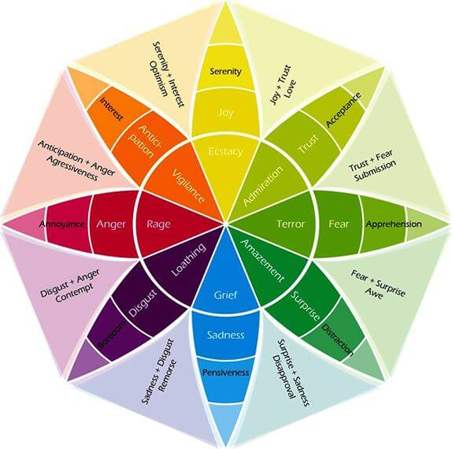

Slide 8
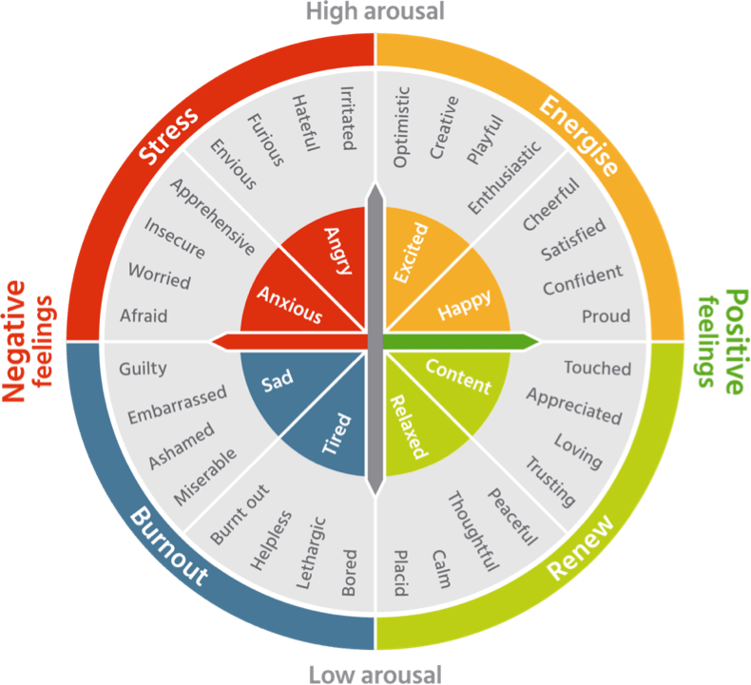

Slide 9
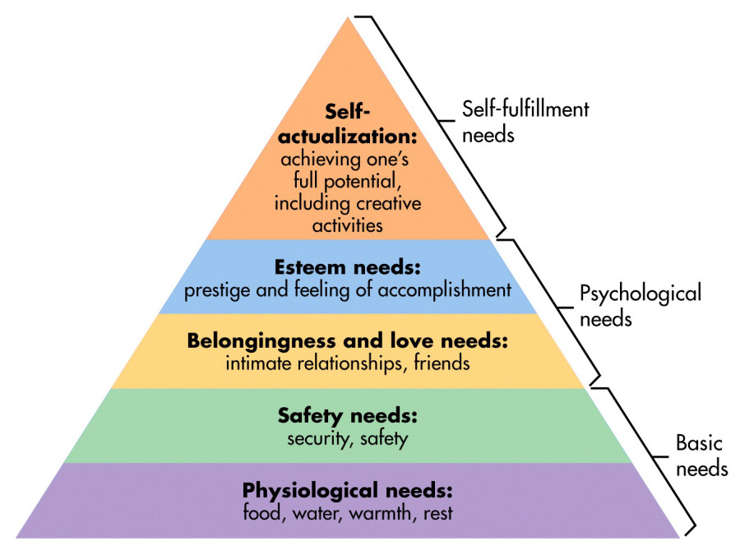

Slide 10
Strategies to Manage Stress and Anxiety
Exercise and eat regularly.
Get enough sleep and have a good sleep routine.
Avoid excess caffeine which can increase feelings of anxiety and agitation.
Avoid illegal drugs, alcohol, and tobacco.

Slide 11
Strategies to Manage Stress and Anxiety
Learn relaxation exercises (abdominal breathing and muscle relaxation techniques).
Develop assertiveness training skills. For example, state feelings in polite, firm, and not overly aggressive or passive ways: ("I feel angry when you yell at me.” "Please stop yelling.”)
Rehearse and practice situations which cause stress. One example is taking a speech class if talking in front of a class makes you anxious.
Learn practical coping skills. For example, break a large task into smaller, more attainable tasks.

Slide 12
Strategies to Manage Stress and Anxiety
Decrease negative self-talk: challenge negative thoughts - with alternative, neutral, or positive thoughts. "My life will never get better” can be transformed into "I may feel hopeless now, but my life will probably get better if I work at it and get some help.”
Learn to feel good about doing a competent or "good enough” job rather than demanding perfection from yourself and others.
Take a break from stressful situations. Activities like listening to music, talking to a friend, drawing, writing, or spending time with a pet can reduce stress.
Build a network of friends who help you cope in a positive way.

Slide 13
I will be OK IF……….
No matter how things turn out, I’ll feel OK if: ________________________________________
No matter what happens I want to remember : _______________________________________
Think about something you are struggling with, or maybe a relationship in or out of your family that you’re having a hard time with….
Ulrich, Wendy, 2016. Time Out for Women. The Spritual Skill of Resiliency
Notes:
Failure is learning
Practicing skills, determination, endurance, faith, hope, serving others who may be challenging
Each experience that is hard and difficult helps us practice this Spiritual Resliency. We need to refer back to prior experiences to help give us HOPE and FAITH.
Failure does not mean something is necessarily wrong with us, it does not mean we give up hope. We may need to try again, or try a different way or go down a different path.
We learn resilience in the company of friends, and family… we learn from the stories of others
They help build our testimony.

Slide 14
D & C 84:88 :
And whoso receiveth you,there I will be also, for I will go before your face. I will be on your right hand and on your left, and my Spirit shall be in your hearts, and mine angels round about you to bear you up”.
Notes:
Christ will be with us, he will prepare the way
-HE DID NOT SAY ANYTHING about not needing to move forward ( we still must endure the trials of life)
-Draw on the Power of heaven – through prayer and scripture study

Slide 15
May You Have Courage
Thomas S Monson
April 2009 General Conference
  “Although there have always been challenges in the world, many of those which you face are unique to this time. But you are some of our Heavenly Father’s strongest children, and He has saved you to come to the earth “for such a time as this.”
With His help, you will have the courage to face whatever comes. Though the world may at times appear dark, you have the light of the gospel, which will be as a beacon to guide your way.
My earnest prayer is that you will have the courage required to refrain from judging others, the courage to be chaste and virtuous, and the courage to stand firm for truth and righteousness. As you do so, you will be “an example of the believers,” and your life will be filled with love and peace and joy.”

Slide 16
Resources
Stress Management and Teens
https://www.aacap.org/AACAP/Families_and_Youth/Facts_for_Families/FFF-Guide/Helping-Teenagers-With-Stress-066.aspx
Top 10 Stress Busters for Teens
https://www.psychologytoday.com/us/blog/teen-angst/201411/top-10-stress-busters-teens
Just For Teens: A Personal Plan for Managing Stress
https://www.aap.org/en-us/professional-resources/Reaching-Teens/Documents/Private/Personal_plan_handout.pdf
Coping Strategies: Many resources available online through a search
Maslows, Abraham (1943). Maslow’s Hierarchy of Needs
https://www.simplypsychology.org/maslow.html
Plutchik’s Wheel of Emotion : https://positivepsychology.com/emotion-wheel/
Feelings Chart: Etsy: JourneytoWellness ( Copyrighted) https://www.etsy.com/shop/JourneyToWellnessNZ

Slide 17
Resources
Monson, Thomas S. April 2009 General Conference. May You Have Courage
Ulrich, Wendy. Time Out For Women 2016. The Spiritual Skill of Resilience.

